Slide 1
The Battle of Neighborhoods (Week 2)
Capstone Project

Slide 2

Introduction
A Mexican chef who moved to New York wants to open a fast food chain of Mexican food. However, He would like to start the business in Manhattan and needs to know if opening the first store there is a good idea.

Slide 3

Data
NY data containing the neighborhoods and boroughs, latitudes, and longitudes from: https://cocl.us/new_york_dataset
Data related to locations of mexican restaurants will be obtained via the FourSquare API.

Slide 4
Methodology
Collect data from NY neighborhoods.
Target to Manhattan data.
Check which are the main commercial establishments in Manhattan.

Slide 5
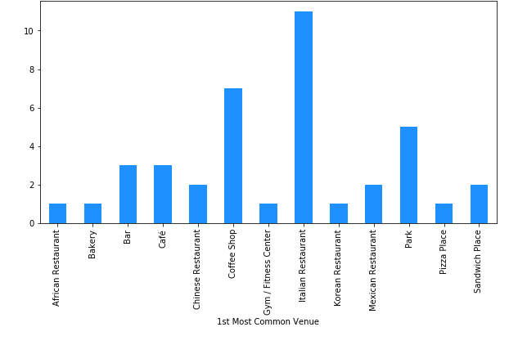
Results
Most common bussines in Manhattan

Slide 6
Conclusion
With the data we can see that there is a possibility to open a Mexican fast food in Manhattan, as there are only two Mexican restaurants in the region.

